Slide 1
Total Recall: Ku Bootcamp Final Project
Danny Zamora, Racheal Spears, Blake Hawkins

Slide 2
What is it?
Total Recall is an app intended for users that may have had life events that alter their ability to recall information.
The app allows users or caregivers to input customizable items that can be used in a word guessing style game.
The app will integrate with Facebook include Facebook contacts with-in the game.
The app will also allow bilingual users to pick alternate languages to recall words. (Google-translate api)

Slide 3
How does it work?
The App integrates API calls for the following functionality:
Facebook used for:
Login
Contacts
Google Translate used for:
Translate works that are identified by the user/caregiver
MongoDB
Used to store customizable input

Slide 4
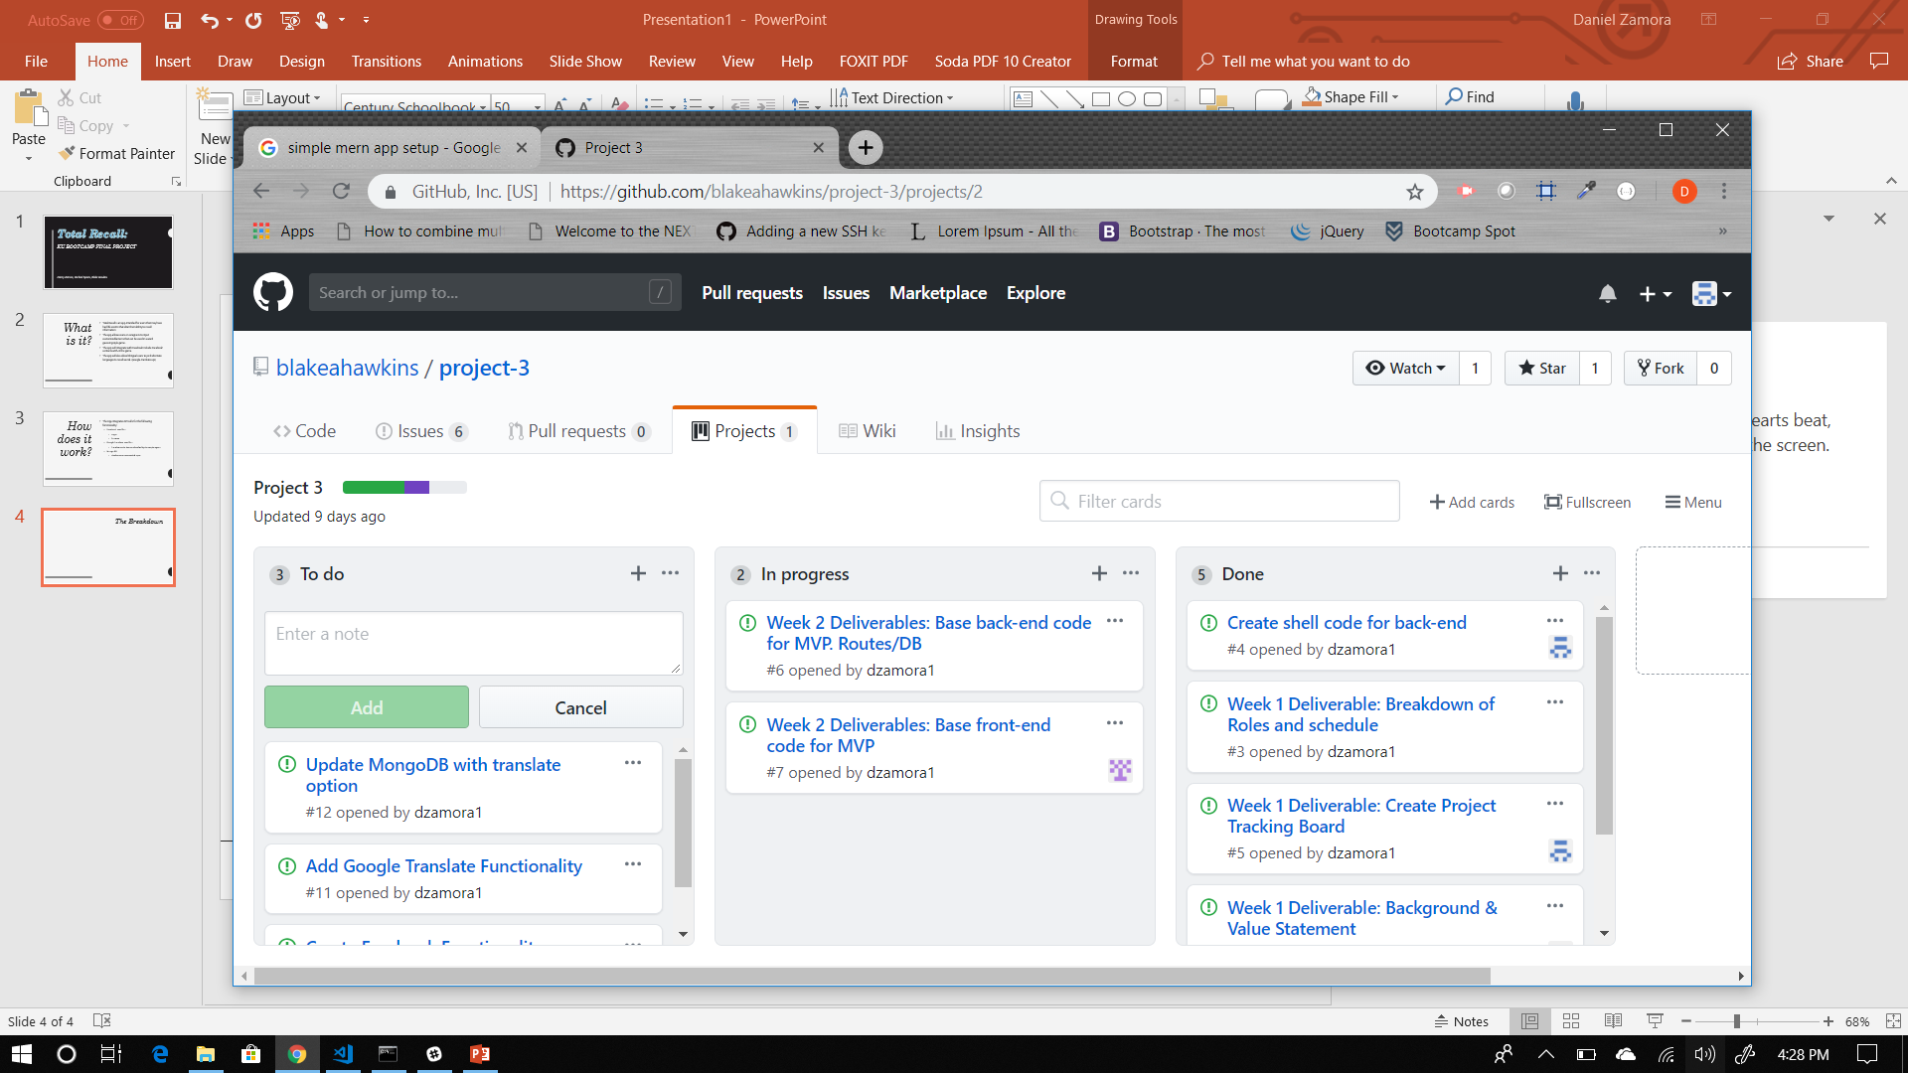
The Breakdown

